Slide 1
JavaScript

Slide 2
Computer Programming Languages

Slide 3
Computer Programming Languages (Contd…):
Programming languages are used to facilitate communication about the task of organizing and manipulating information, and to express algorithms precisely.
For 50 years, computer programmers have been writing code. New technologies continue to emerge, develop, and mature at a rapid pace. Now there are more than 2,500 documented programming languages!

Slide 4
Non-computational languages:
Non-computational languages, such as markup languages like HTML or formal grammars like BNF, are usually not considered programming languages.

Slide 5
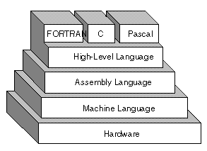
Machine language:
It is the lowest-level programming language.
Machine languages are the only languages understood by computers.

Slide 6
Machine language:
While easily understood by computers, machine languages are almost impossible for humans to use because they consist entirely of numbers.
For example, an x86/ia-32 processor can execute the following binary instruction as expressed in machine language:
Binary: 10110000 01100001 (Hexadecimal: 0xb061)

Slide 7
Assembly Level Language:
An assembly language is a low-level language for programming computers.
The word "low" does not imply that the language is inferior to high-level programming languages but rather refers to the small or nonexistent amount of abstraction between the language and machine language, because of this, low-level languages are sometimes described as being "close to the hardware."
It implements a symbolic representation of the numeric machine codes and other constants needed to program a particular cpu architecture.

Slide 8
Assembly Level Language (cont.…):
A utility program called an assembler, is used to translate assembly language statements into the target computer's machine code.
The assembler performs a more or less isomorphic translation (a one-to-one mapping) from mnemonic statements into machine instructions and data.
Example: assembly language representation is easier to remember (more mnemonic)
Mov al, 061h
this instruction means:
Move the hexadecimal value 61 (97 decimal) into the processor register named "al".
The mnemonic "mov" is an operation code or opcode, a comma-separated list of arguments or parameters follows the opcode;

Slide 9
Example (Adds 2 numbers):
name "add"
mov al, 5 ; bin=00000101b
mov bl, 10 ; hex=0ah or bin=00001010b
add bl, al ; 5 + 10 = 15 (decimal) or hex=0fh or
bin=00001111b

Slide 10
High-level language:
High-level languages are relatively easy to learn because the instructions bear a close resemblance to everyday language, and because the programmer does not require a detailed knowledge of the internal workings of the computer.
Each instruction in a high-level language is equivalent to several machine-code instructions, therefore it is more compact than equivalent low-level programs.
High-level languages are used to solve problems and are often described as problem-oriented languages

Slide 11
High-level language (Contd…):
Examples of HLL:
BASIC was designed to be easily learnt by first-time programmers;
COBOL is used to write programs solving business problems;
FORTRAN is used for programs solving scientific and mathematical problems.
With the increasing popularity of windows-based systems, the next generation of programming languages was designed to facilitate the development of gui interfaces;
For example, visual basic wraps the BASIC language in a graphical programming environment.
Support for object-oriented programming has also become more common, for example in c++ and java.

Slide 12
Example (C program to add 2 numbers):
#include<stdio.h> //header files
Void main()
{
int a, b, c; // declaration of 3 variables
printf(“Enter two numbers:\n”);
Scanf(“%d”, &a); // read 1st number
Scanf(“%d”, &b); // read 2nd number
c=a+b; // compute the sum
printf(“Sum of 2 numbers is %d”, c); //print sum
}

Slide 13
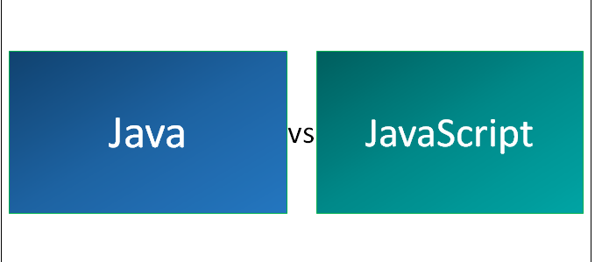

Slide 14
Java is an OOP (object-oriented programming) language which came to usage in 1995. Java was designed by James Gosling and its major implementation was Open JDK .Java was developed at sun microsystems which later acquired by Oracle. Programs or applications developed in Java will execute in a JVM (Java virtual machine) by which we can run the same program on multiple platforms and systems/devices etc. If we want to run Java program on the browser we need to use Java applets which are embedded as a plugin which is not suggested.
JavaScript was created by Brendan Eich at Netscape which came into existence in 1995. It runs on web-browser only and it is an interpreted programming language. JavaScript is an object-oriented scripting language which allows you to create dynamic HTML pages with interactive effects within a webpage.

Slide 15
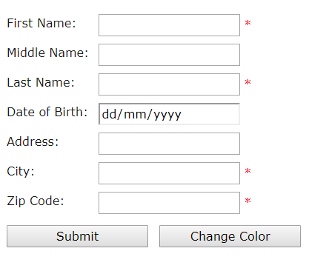
JavaScript
JavaScript is a loosely-typed client side scripting language that executes in the user's browser. JavaScript interact with html elements (DOM elements) in order to make interactive web user interface.
JavaScript can be used in various activities like data validation, display popup messages, handling different events of DOM elements, modifying style of DOM elements etc. The following sample form uses JavaScript to validate data and change color of form.

Slide 16
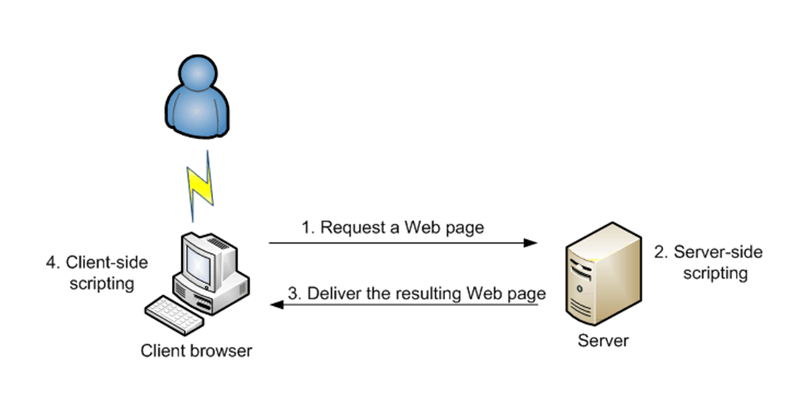
Once you have entered the address of the page you want or clicked a link, your browser requests that page from the server (1). The server then finds the page, opens it and runs all server-side scripts in it. For example, if it is a PHP or an ASPX (ASP.NET) page, the server will execute all code on the page (2). After all the server-side scripts are processed, the result is sent back to the browser (3). The result is a page that has HTML and CSS code, and optionally, client-side scripting code. If there is client-side scripting code on the page (for example, JavaScript), the browser will process it (4) and display it to the user. It will also keep processing it and running it when necessary as long the page is displayed in the browser.

Slide 17
Advantages of JavaScript
JavaScript is easy to learn.
It executes on client's browser, so eliminates server side processing.
It executes on any OS.
JavaScript can be used with any type of web page e.g. PHP, ASP.NET, Perl etc.
Performance of web page increases due to client side execution.
JavaScript code can be minified to decrease loading time from server.
Many JavaScript based application frameworks are available in the market to create Single page web applications e.g. ExtJS, AngularJS, KnockoutJS etc.

Slide 18
Question 1.1: Here are a few programming actions that are usually run on the server, on the client or can be run on both.
Check the appropriate boxes.
Action | Server | Client
Online browser games
Online questionnaires with results
Validation of user’s input in forms
Scrolling text

Slide 19
JavaScript is case-sensitive,
alert("Hello!");
ALERT("Hello!"); //illegal
aLeRt("Hello!"); //illegal
//used for single line comment
/* multiple line comment */

Slide 20
Essence of the JavaScript console
Go to the 'Console' tab in the browser console.
Type random junk next to the > sign and press enter.
Now type 1 + 1 and press enter.
Next, type alert("This computer does what [name] tells it to do"). Mind the double quotes and parentheses. Substitute your name for [name].

Slide 21
This part is the essence of the JavaScript console: you get to type in a one-line program, and the browser will run it for you, and tell you what the result was. If you write something that is not a valid program, it will try to tell you what went wrong.
The first program, 1 + 1, won't look too foreign. You should read it as a series of commands to the computer: give me the number one, now give me another one, now add them both together.
The second program (alert(…)) is a function call. Functions are operations that can be invoked. The function available under the name alert is an operation for showing a little dialog window on the screen. The parentheses are the notation for invoking a function, and the values in between them are given to the function as further info. In this case, it told the alert function which text to display.

Slide 22
Adding the JavaScript tag
You add JavaScript to a page with the <script> tag, like this:
<script type=”text/javascript”>
// JavaScript goes here
</script>
You may see various ways to include JavaScript in a page, like “text/ecmascript” or without the type attribute at all, just an empty <script>tag.

Slide 23
Adding JavaScript to a page’s HTML
Always position the JavaScript code after the opening <script type=”text/javascript”> tag and before the closing </script> tag. You can include those tags in both the <head> section and the <body> section of a page.
You could actually place as many of those separate script elements as you want on a page but there’s usually no reason to do so.

Slide 24
<!doctype html>
<html>
<head>
<title>Another Basic Page</title>
<script type=”text/javascript”>
// JavaScript goes here
</script>
</head>
<body>
<h1>Here’s another basic page</h1>
<script type=”text/javascript”>
// JavaScript can also go here
</script>
</body>
</html>

Slide 25
Using external JavaScript
Using external JavaScript files is the same concept as using external files for CSS. Doing so promotes reusability and makes troubleshooting and changes easier.
You can add external JavaScript by using the src attribute, like this: <script type=”text/javascript” src=”externalfile.js”></script>
This example loads the file “externalfile.js” from the same directory on the web server. The contents of that file are expected to be JavaScript.

Slide 26
<!doctype html> <html> <head> <title>Another Basic Page</title> <script type=”text/javascript” src=”externalfile.js”></ script> <script type=”text/javascript”> // JavaScript goes here </script> </head> <body> <h1>Here’s another basic page</h1> </body> </html> | Notice in this example that there’s nothing between the opening <script> and closing </script> tags. When using an external JavaScript file, you can’t put JavaScript within that same set of tags. You could add a reference, like the one shown, anywhere in the page, but the traditional spot for that is in the <head> section of the page. Also note there’s nothing preventing you from using an external JavaScript file along with in-page JavaScript, so this is perfectly valid:

Slide 27
JavaScript Output
JavaScript Display Possibilities
JavaScript can "display" data in different ways:
Writing into an HTML element, using innerHTML.
Writing into the HTML output using document.write().
Writing into an alert box, using window.alert().
Writing into the browser console, using console.log().

Slide 28
Using innerHTML
To access an HTML element, JavaScript can use the document.getElementById(id)method. The id attribute defines the HTML element. The innerHTML property defines the HTML content Changing the innerHTML property of an HTML element is a common way to display data in HTML. | <!DOCTYPE html> <html> <body> <h1>My First Web Page</h1> <p>My First Paragraph</p> <p id="demo"></p> <script> document.getElementById("demo").innerHTML = 5 + 6; </script> </body> </html>
My First Web Page My First Paragraph. 11

Slide 29
Using document.write()
For testing purposes, it is convenient to use document.write(): | <!DOCTYPE html> <html> <body> <h2>My First Web Page</h2> <p>My first paragraph.</p> <p>Never call document.write after the document has finished loading. It will overwrite the whole document.</p> <script> document.write(5 + 6); </script> </body> </html>
My First Web Page My first paragraph. Never call document.write after the document has finished loading. It will overwrite the whole document. 11

Slide 30
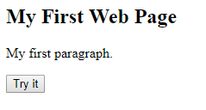
Using document.write() after an HTML document is loaded, will delete all existing HTML | <!DOCTYPE html> <html> <body> <h2>My First Web Page</h2> <p>My first paragraph.</p> <button type="button" onclick="document.write(5 + 6)">Try it</button> </body> </html>
The document.write() method should only be used for testing. Think about the use of document.write() | 11

Slide 31
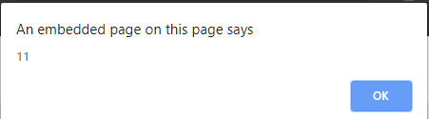
Using window.alert()
You can use an alert box to display data: | <!DOCTYPE html> <html> <body> <h2>My First Web Page</h2> <p>My first paragraph.</p> <script> window.alert(5 + 6); </script> </body> </html>

Slide 32
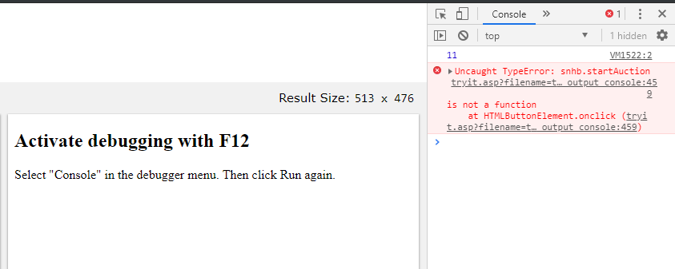
Using Console.log()
For debugging purposes, you can use the console.log() method to display data | <!DOCTYPE html> <html> <body> <h2>Activate debugging with F12</h2> <p>Select "Console" in the debugger menu. Then click Run again.</p> <script> console.log(5 + 6); </script> </body> </html>

Slide 33
JavaScript Keywords
Keyword | Description
break | Terminates a switch or a loop
continue | Jumps out of a loop and starts at the top
debugger | Stops the execution of JavaScript, and calls (if available) the debugging function
do ... while | Executes a block of statements, and repeats the block, while a condition is true
for | Marks a block of statements to be executed, as long as a condition is true
function | Declares a function
if ... else | Marks a block of statements to be executed, depending on a condition
return | Exits a function
switch | Marks a block of statements to be executed, depending on different cases
try ... catch | Implements error handling to a block of statements
var | Declares a variable

Slide 34
Variables in JavaScript
A variable is a name given to a memory location. It is the basic unit of storage in a program. A variable is a container, like a matchbox, holding pieces of information.
The value stored in a variable can be changed during program execution.
A variable is only a name given to a memory location, all the operations done on the variable effects that memory location.
In JavaScript, all the variables must be declared before they can be used.
To declare a variable in JavaScript, we must use the keyword var followed by the name of the variable and semi-colon. Below is the syntax to create variables in JavaScript:
var var_name;

Slide 35
JavaScript supports 3 primitive datatypes:
Numbers: 5, 6.5, 7 etc.
String: “Hello GeeksforGeeks” etc.
Boolean: true, false.
Except for the above three primitive data types, JavaScript also supports two trivial datatypes null and undefined and one composite datatype object.

Slide 36
var x, y, z; // How to declare variables
x = 5; y = 6; // How to assign values
z = x + y; // How to compute values

Slide 37
JavaScript Identifiers
All JavaScript variables must be identified with unique names.
These unique names are called identifiers.
Identifiers can be short names (like x and y) or more descriptive names (age, sum, totalVolume).
The general rules for constructing names for variables (unique identifiers) are:
Names can contain letters, digits, underscores, and dollar signs.
Names must begin with a letter
Names can also begin with $ and _
Names are case sensitive (y and Y are different variables)
Reserved words (like JavaScript keywords) cannot be used as names
JavaScript identifiers are case-sensitive.

Slide 38
The Assignment Operator
In JavaScript, the equal sign (=) is an "assignment" operator, not an "equal to" operator.
This is different from algebra. The following does not make sense in algebra:
x = x + 5
In JavaScript, however, it makes perfect sense: it assigns the value of x + 5 to x.
(It calculates the value of x + 5 and puts the result into x. The value of x is incremented by 5.)
The "equal to" operator is written like == in JavaScript.

Slide 39
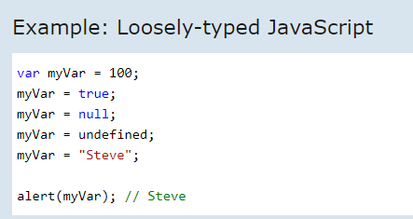
JavaScript Data Types
JavaScript includes data types similar to other programming languages like Java or C#. Data type indicates characteristics of data. It tells the compiler whether the data value is numeric, alphabetic, date etc., so that it can perform the appropriate operation.
JavaScript includes primitive and non-primitive data types as per latest ECMAScript 5.1.
Primitive Data Types
String
Number
Boolean
Null
Undefined
Non-primitive Data Type
Object
Date
Array
JavaScript is a dynamic or loosely-typed language because a variable can hold value of any data type at any point of time.

Slide 40
JavaScript Arithmetic Operators
Arithmetic operators are used to perform arithmetic on numbers:
Operator | Description
+ | Addition
- | Subtraction
* | Multiplication
** | Exponentiation (ES2016)
/ | Division
% | Modulus (Division Remainder)
++ | Increment
-- | Decrement

Slide 41
JavaScript Assignment Operators Assignment operators assign values to JavaScript variables.
Operator | Example | Same As
= | x = y | x = y
+= | x += y | x = x + y
-= | x -= y | x = x - y
*= | x *= y | x = x * y
/= | x /= y | x = x / y
%= | x %= y | x = x % y
**= | x **= y | x = x ** y
More on operators https://www.w3schools.com/js/js_operators.asp

Slide 42
Explain Output
<script type="text/javascript" language="javascript">
/* Example: Variables
Comment here
Comment here
*/
a = "Hello world!";
b = 5;
c = "17";
d = 3.25;
alert(a + b);
alert(b + c);
alert(b + d);
</script>
alert(a + b); // "Hello world!" + 5 = "Hello world!5" alert(b + c); // 5 + "17" = "517" alert(b + d); // 5 + 3.25 = 8.25

Slide 43
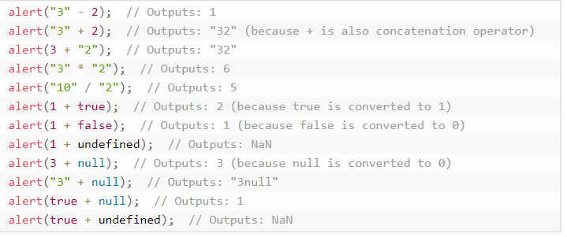

Slide 44
String
String is a primitive data type in JavaScript. A string is textual content. It must be enclosed in single or double quotation marks.
A string is immutable in JavaScript, it can be concatenated using plus (+) operator in JavaScript
str = 'Hello ' + "World " + 'from ' + ‘Hamilton ';
If you want to include same quotes in a string value as surrounding quotes then use backward slash (\) before quotation mark inside string value
var str1 = "This is \"simple\" string";
var str2 = 'This is \'simple\' string';
var str1 = "Hello World";

Slide 45
String-Methods
https://www.w3schools.com/js/js_string_methods.asp

Slide 46
JavaScript Number
The Number is a primitive data type in JavaScript. Number type represents integer, float, hexadecimal, octal or exponential value.
var x = 3.14; // A number with decimals var y = 3; // A number without decimals
var x = 123e5; // 12300000 var y = 123e-5; // 0.00123

Slide 47
Number Properties
The Number type includes some default properties. JavaScript treats primitive values as object, so all the properties and methods are applicable to both primitive number values and number objects.
Property | Description
MAX_VALUE | Returns the maximum number value supported in JavaScript
MIN_VALUE | Returns the smallest number value supported in JavaScript
NEGATIVE_INFINITY | Returns negative infinity (-Infinity)
NaN | Represents a value that is not a number.
POSITIVE_INFINITY | Represents positive infinity (Infinity).

Slide 48
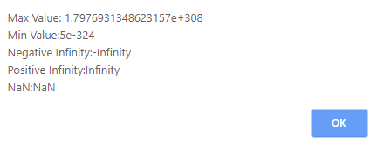
<!DOCTYPE html>
<html>
<body>
<h1>Demo: Number object comparison</h1>
<script>
alert(' Max Value: ' + Number.MAX_VALUE +
'\n Min Value:' + Number.MIN_VALUE +
'\n Negative Infinity:' + Number.NEGATIVE_INFINITY +
'\n Positive Infinity:' + Number.POSITIVE_INFINITY +
'\n NaN:' + Number.NaN
);
</script>
</body>
</html>

Slide 49
number_methods
https://www.w3schools.com/js/js_number_methods.asp

Slide 50
JavaScript Boolean
Boolean can have only two values, true or false. It is useful in controlling program flow using conditional statements like if..else, switch, while, do..while.
Method | Description
toLocaleString() | Returns string of boolean value in local browser environment. Example: var result = (1 > 2); result.toLocaleString(); // returns "false"
toString() | Returns a string of Boolean. Example: var result = (1 > 2); result.toString(); // returns "false"
valueOf() | Returns the value of the Boolean object. Example: var result = (1 > 2); result.valueOf(); // returns false

Slide 51
JavaScript Object
Object is a non-primitive data type in JavaScript. It is like any other variable, the only difference is that an object holds multiple values in terms of properties and methods. Properties can hold values of primitive data types and methods are functions
Example – A person
var <object-name> = { key1: value1, key2: value2,... keyN: valueN};

Slide 52
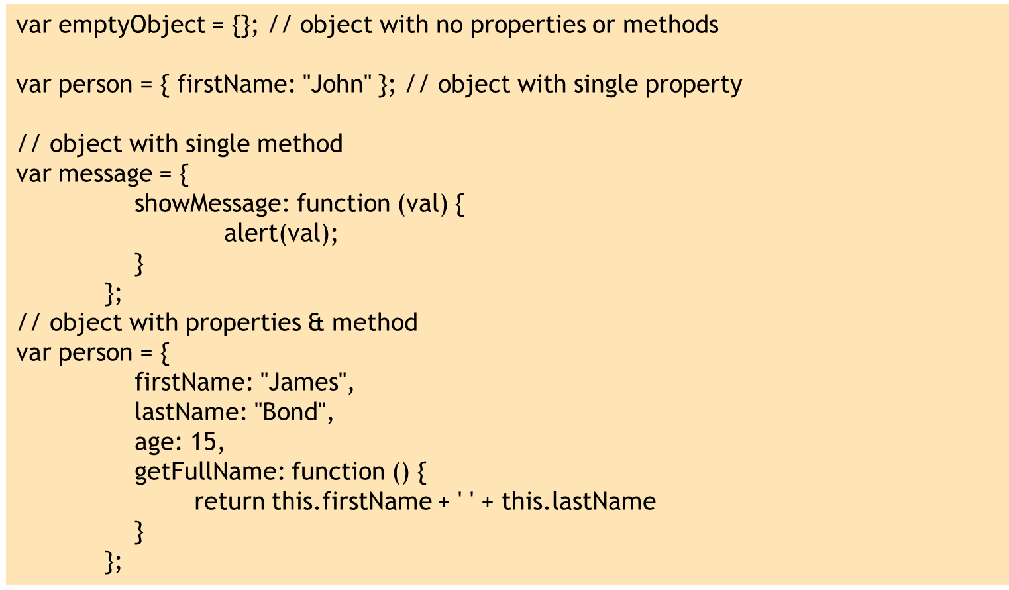
Create Object using Object Literal Syntax

Slide 53
Access JavaScript Object Properties & Methods
var person = {
firstName: "James",
lastName: "Bond",
age: 25,
getFullName: function () {
return this.firstName + ' ' + this.lastName
}
};
person.firstName; // returns James
person.lastName; // returns Bond
person["firstName"];// returns James
person["lastName"];// returns Bond
person.getFullName();
You can get or set values of an object's properties using dot notation or bracket. However, you can call an object's method only using dot notation.

Slide 54
Object Constructor
var person = new Object();
// Attach properties and methods to person object
person.firstName = "James";
person["lastName"] = "Bond";
person.age = 25;
person.getFullName = function () {
return this.firstName + ' ' + this.lastName;
};
// access properties & methods
person.firstName; // James
person.lastName; // Bond
person.getFullName(); // James Bond
The second way to create an object is with Object Constructor using new keyword. You can attach properties and methods using dot notation. Optionally, you can also create properties using [ ] brackets and specifying property name as string.

Slide 55
Date ( )
JavaScript provides Date object to work with date & time including days, months, years, hours, minutes, seconds and milliseconds.
document.getElementById(“id").innerHTML = Date();
var currentDate = new Date();
document.getElementById("p2").innerHTML = currentDate;
No Parameter: Date object will be set to current date & time if no parameter is specified in the constructor.
Milliseconds: Milliseconds can be specified as numeric parameter. The date object will calculate date & time by adding specified numeric milliseconds from mid night of 1/1/1970
Date string: String parameter will be treated as a date and will be parsed using Date.parse method.

Slide 56
The getTime() Method- returns the number of milliseconds since January 1, 1970:
Set Date methods let you set date values (years, months, days, hours, minutes, seconds, milliseconds) for a Date Object.
Practice all methods
Exercise- set your date of birth.

Slide 57
JavaScript Break and Continue
The break statement breaks the loop and continues executing the code after the loop (if any):
for (i = 0; i < 10; i++) { if (i === 3) { break; } text += "The number is " + i + "<br>"; }
The continue statement breaks one iteration (in the loop), if a specified condition occurs, and continues with the next iteration in the loop.
This example skips the value of 3:
for (i = 0; i < 10; i++) { if (i === 3) { continue; } text += "The number is " + i + "<br>"; }

Slide 58
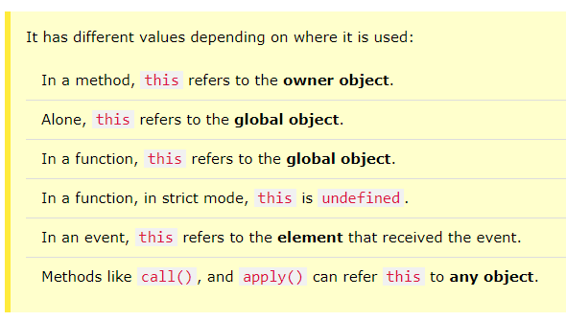
this in JavaScript
The this keyword is one of the most widely used and yet confusing keyword in JavaScript. Here, you will learn everything about this keyword.
this points to a particular object. Now, which is that object is depends on how a function which includes 'this' keyword is being called.
The following four rules applies to this in order to know which object is referred by this keyword.
Global Scope
Object's Method
call() or apply() method
bind() method

Slide 59
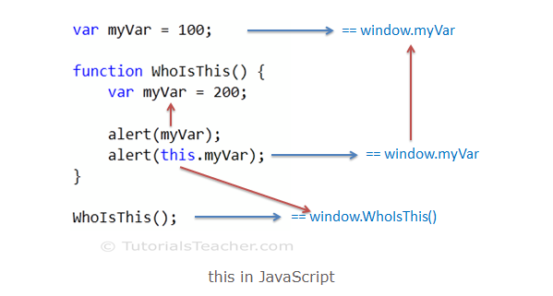
Global Scope

Slide 60
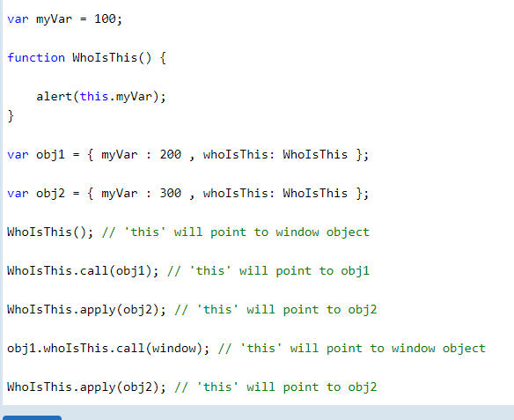
call() & apply()

Slide 61
Error handling in JavaScript
JavaScript is a loosely-typed language. It does not give compile time. So some times you will get a runtime error for accessing an undefined variable or calling undefined function etc.
try catch block does not handle syntax errors.
JavaScript provides error-handling mechanism to catch runtime errors using try-catch-finally block, similar to other languages like Java or C#.

Slide 62
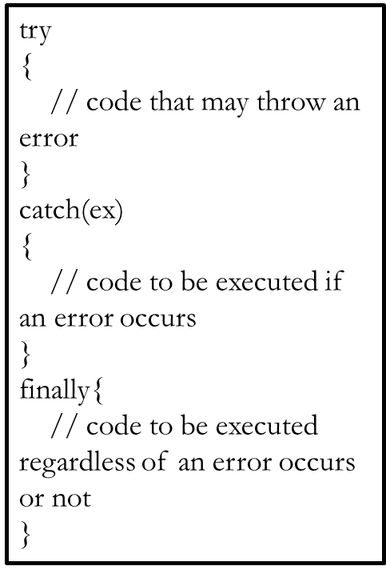
try: wrap suspicious code that may throw an error in try block.
catch: write code to do something in catch block when an error occurs. The catch block can have parameters that will give you error information. Generally catch block is used to log an error or display specific messages to the user.
finally: code in the finally block will always be executed regardless of the occurrence of an error. The finally block can be used to complete the remaining task or reset variables that might have changed before error occurred in try block.

Slide 63
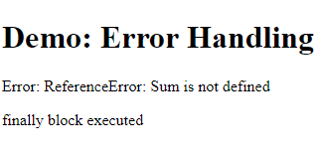
<!DOCTYPE html>
<html>
<body>
<h1>Demo: Error Handling</h1>
<p id="errorMessage">Error: </p>
<p id="message"></p>
<script>
try
{
var result = Sum(10, 20); // Sum is not defined yet
}
catch(ex)
{
document.getElementById("errorMessage").innerHTML += ex;
}
finally{
document.getElementById("message").innerHTML = "finally block executed";
}
</script>
</body>
</html>

Slide 64
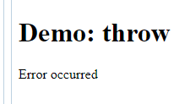
throw Use throw keyword to raise a custom error.
<script>
try
{
throw "Error occurred";
}
catch(ex)
{
document.getElementById("errorMessage").innerHTML = ex;
}

Slide 65
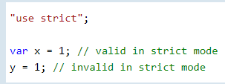
JavaScript strict mode
JavaScript is a loosely typed (dynamic) scripting language. If you have worked with server side languages like Java or C#, you must be familiar with the strictness of the language. For example, you expect the compiler to give an error if you have used a variable before defining it.
JavaScript allows strictness of code using "use strict" with ECMAScript 5 or later. Write "use strict" at the top of JavaScript code or in a function.

Slide 66
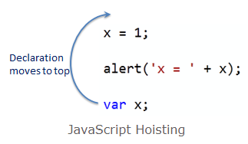
JavaScript Hoisting
Hoisting is a concept in JavaScript, not a feature. In other scripting or server side languages, variables or functions must be declared before using it.
In JavaScript, variable and function names can be used before declaring it. The JavaScript compiler moves all the declarations of variables and functions at the top so that there will not be any error. This is called hoisting.

Slide 67
Practice
Best Practice and Mistakes
Self directed- math, type conversion, and debugging.

Slide 68
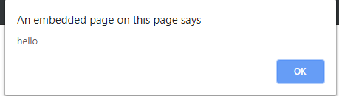
Sending an alert to the screen
The alert() method displays an alert box with a specified message and an OK button.
An alert box is often used if you want to make sure information comes through to the user.
Note: The alert box takes the focus away from the current window, and forces the browser to read the message. Do not overuse this method, as it prevents the user from accessing other parts of the page until the box is closed.
<!doctype html>
<html>
<head>
<title>Another Basic Page</title>
</head>
<body>
<h1>Here’s another basic page</h1>
<script>
alert("hello")
</script>
</body>
</html>

Slide 69
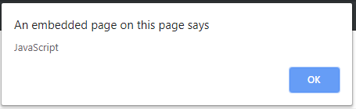
Alert using variable
<script>
var mystring="Java"+"Script";
alert(mystring);

Slide 70
Confirm( )
The confirm() method displays a dialog box with a specified message, along with an OK and a Cancel button.
A confirm box is often used if you want the user to verify or accept something.
Note: The confirm box takes the focus away from the current window, and forces the browser to read the message. Do not overuse this method, as it prevents the user from accessing other parts of the page until the box is closed.
The confirm() method returns true if the user clicked "OK", and false otherwise.

Slide 71
<!DOCTYPE html>
<html>
<body>
<p>Click the button to display a confirm box.</p>
<button onclick="myFunction()">Try it</button>
<p id="demo"></p>
<script>
function myFunction() {
var txt;
var r = confirm("Press a button!");
if (r == true) {
txt = "You pressed OK!";
} else {
txt = "You pressed Cancel!";
}
document.getElementById("demo").innerHTML = txt;
}
</script>
</body>
</html>

Slide 72
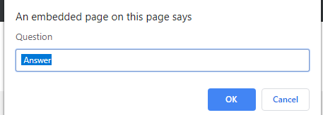
Prompt( )
Prompt:-This method can have two parameters, one with the question and one with the default answer. Unlike the alert method, the prompt method returns a result - the text user has entered in the window.
result = prompt("Question?", "Answer");
<script> ScriptPrompt = prompt("Question", " Answer"); </script>

Slide 73
Function
Functions are defined with the function keyword followed by the name and parentheses. Inside the parentheses you can, optionally, define any variables that are given to the function – these variables are called parameters of the function. Function allows you to define a block of code, give it a name and then execute it as many times as you want.
//defining a function function <function-name>() { // code to be executed }; //calling a function function-name() | <!DOCTYPE html> <html> <body> <h1>Demo: JavaScript function</h1> <script> function ShowMessage() { alert("Hello World!"); } ShowMessage(); </script> </body> </html>

Slide 74
<script>
function sayHello()
{
alert("Hello!");
}
function say(text)
{
alert(text);
}
function addNumbers(a, b)
{
result = a + b;
return result;
}
sayHello(); // calls the function
say("How are you doing?"); // calls the function
x= addNumbers(5, 17); // calls the function
alert(x);
</script>

Slide 75
Local and global variables
Functions are independent parts of code, so they can create and use variables that already exist in the main code (or the code outside of any function). Such variables are called local variables. To declare a local variable inside of the function use the var keyword. Local variables are totally independent of the rest of the JavaScript code, as they are used only inside the function that they are declared in. | number = 5; function showNumber() { var number = 12; // local variable alert(number); } alert(number); // 5 12 5 showNumber(); // 12 5 12 alert(number); // 12 5 5
How to get this

Slide 76
Functions can normally return only one value with the return command Every variable that isn’t explicitly declared with var in the function will be considered a global variable Local and global variables can give you headaches if not used properly Also notice how the code is actually executed. It is read line by line and the functions are executed only when called. Functions can call other functions, but if you put all of your code inside functions and nothing as the main code, then nothing will happen. | number = 5; function addNumbers(a, b) { number = a + b; // Not proper use of global variable here alert(number); } addNumbers(4, 2); // 6 alert(number); // 6 addNumbers(2, 9); // 11 alert(number); // 11

Slide 77
isNaN()
JavaScript includes a function to test whether something is a number. The
function is called isNaN(), which stands for is not a number. This can be
added anywhere that you need to test to make sure something is a number
before working with it, like in the case of the addNumbers() function
function addNumbers(num1,num2) {
if (isNaN(num1)) {
alert(num1 + “ is not a number”);
} else if (isNaN(num2)) {
alert(num2 + “ is not a number”);
} else {
alert(num1+num2);
}
}

Slide 78
Returning results from functions
<!doctype html>
<html>
<head>
<title>JavaScript </title>
</head>
<body>
<h1>Here’s another basic page</h1>
<script type=”text/javascript”>
// Define the function
function addNumbers(num1,num2) {
var result = num1+num2;
return result;
}
// Call the function
var myResult = addNumbers(49,2);
</script>
</body>
</html>
The function that you created in this section sends an alert. But there are times when you want to have the function send something back to you — to do something and then return the results.
The return keyword is used to return results from a function. In the addNumbers() function example shown, instead of using an alert() right within the function you could return the result. Here’s an example:
function addNumbers(num1,num2) {
var result = num1+num2;
return result;
}
You can call the function just like before, but you now need to capture the
result, typically into another variable, like this:
var myResult = addNumbers(49,2);

Slide 79
Self Study
https://www.w3schools.com/js/js_function_definition.asp

Slide 80
JavaScript and Cookies
Web Browsers and Servers use HTTP protocol to communicate and HTTP is a stateless protocol. But for a commercial website, it is required to maintain session information among different pages. For example, one user registration ends after completing many pages. But how to maintain users' session information across all the web pages.
In many situations, using cookies is the most efficient method of remembering and tracking preferences, purchases, commissions, and other information required for better visitor experience or site statistics.
The data contained in a cookie is automatically transmitted between the web browser and the web server, so CGI scripts on the server can read and write cookie values that are stored on the client.
JavaScript can also manipulate cookies using the cookie property of the Document object. JavaScript can read, create, modify, and delete the cookies that apply to the current web page.

Slide 81
How It Works ?
Your server sends some data to the visitor's browser in the form of a cookie. The browser may accept the cookie. If it does, it is stored as a plain text record on the visitor's hard drive. Now, when the visitor arrives at another page on your site, the browser sends the same cookie to the server for retrieval. Once retrieved, your server knows/remembers what was stored earlier.
Cookies are a plain text data record of 5 variable-length fields −
Expires − The date the cookie will expire. If this is blank, the cookie will expire when the visitor quits the browser.
Domain − The domain name of your site.
Path − The path to the directory or web page that set the cookie. This may be blank if you want to retrieve the cookie from any directory or page.
Secure − If this field contains the word "secure", then the cookie may only be retrieved with a secure server. If this field is blank, no such restriction exists.
Name=Value − Cookies are set and retrieved in the form of key-value pairs

Slide 82
JavaScript - Events
An event is something that happens when user interact with the web page, such as when he clicked a link or button, entered text into an input box or textarea, made selection in a select box, pressed key on the keyboard, moved the mouse pointer, submits a form, etc. In some cases, the Browser itself can trigger the events, such as the page load and unload events.
When an event occur, you can use a JavaScript event handler (or an event listener) to detect them and perform specific task or set of tasks. By convention, the names for event handlers always begin with the word "on", so an event handler for the click event is called onclick, similarly an event handler for the load event is called onload, event handler for the blur event is called onblur, and so on.
There are several ways to assign an event handler. The simplest way is to add them directly to the start tag of the HTML elements using the special event-handler attributes. For example, to assign a click handler for a button element, we can use onclick attribute, like this: <button type="button" onclick="alert('Hello World!')">Click Me</button>
https://www.tutorialspoint.com/html/html_events_ref.htm
Details Later

Slide 83
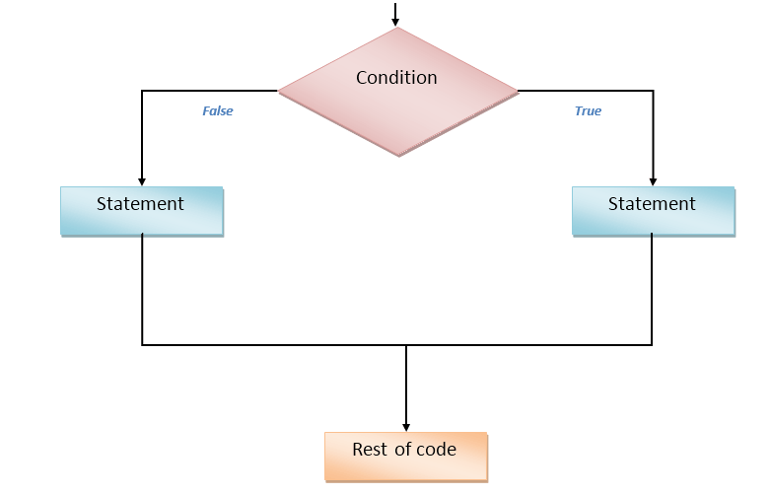
Selection statement: if .. else
Conditional statements are used to decide the flow of execution based on different conditions. If a condition is true, you can perform one action and if the condition is false, you can perform another action.
There are mainly three types of conditional statements in JavaScript.
If statement
If…Else statement
If…Else If…Else statement

Slide 84
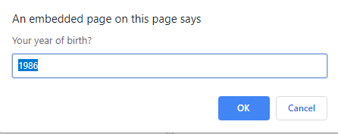
<script type="text/javascript" language="javascript"> yearOfBirth = prompt("Your year of birth?", "1986"); if (yearOfBirth == 1986) { alert("You were born the same year as me!"); } </script>
Operator | Description
< | Less
<= | Less or equal
== | Equal
>= | Bigger or equal
> | Bigger
!= | Not equal (different)

Slide 85
Outcomes is a boolean type (true or false) which is either true or false A = B; // assignment operator if (A == B) // equality operator All of these operators result in true or false values. For example, here’s how you could check several conditions: number = 15; if (number > 10) { } // true if (number != 39) { } // true if (number <= 15) { } // true if (number == 10) { } // false
Operator | Description
< | Less
<= | Less or equal
== | Equal
>= | Bigger or equal
> | Bigger
!= | Not equal (different)

Slide 86
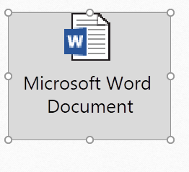
Page-19 & Exercise 2

Slide 87
Activity
Use the if-else statement to check if the weather is good for mowing or not.
Create two local variable with value
If temperature is above 30 , alert it’s too hot to mow
Else If weather is raining alert its raining , can’t mow
Else alert let’s mow

Slide 88
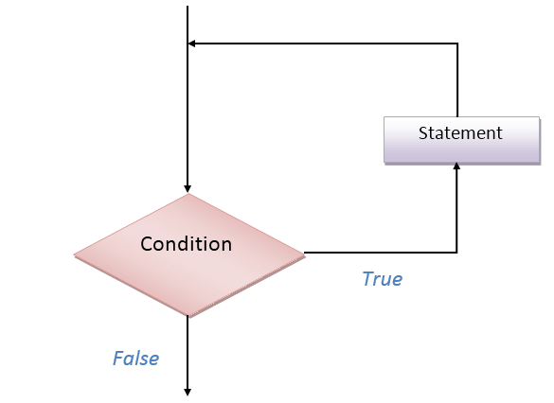
Iteration statements: looping through code
Loops are useful when you have to execute the same lines of code repeatedly, for a specific number of times or as long as a specific condition is true. Suppose you want to type a ‘Hello’ message 100 times in your webpage. Of course, you will have to copy and paste the same line 100 times. Instead, if you use loops, you can complete this task in just 3 or 4 lines.

Slide 89
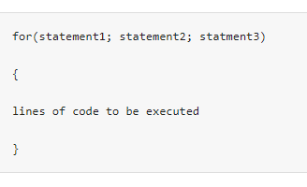
for loop
The statement1 is executed first even before executing the looping code. So, this statement is normally used to assign values to variables that will be used inside the loop.
The statement2 is the condition to execute the loop.
The statement3 is executed every time after the looping code is executed.

Slide 90
<!doctype html>
<html>
<head>
<title>JavaScript Chapter 2</title>
</head>
<body>
<h1>Here’s another basic page</h1>
<script>
for (i = 0; i < 10; i++) {
alert("The variable i is currently set to" + " "+ i);
}
</script>
</body>
</html>

Slide 91
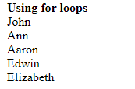
<html> <head> <script type="text/javascript"> var students = new Array("John", "Ann", "Aaron", "Edwin", "Elizabeth"); document.write("<b>Using for loops </b><br />"); for (i=0;i<students.length;i++) { document.write(students[i] + "<br />"); } </script> </head> <body> </body> </html>

Slide 92
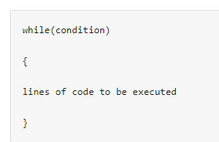
while loop
The “while loop” is executed as long as the specified condition is true. Inside the while loop, you should include the statement that will end the loop at some point of time. Otherwise, your loop will never end and your browser may crash.

Slide 93
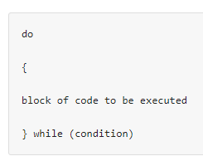
do…while loop
The do…while loop is very similar to while loop. The only difference is that in do…while loop, the block of code gets executed once even before checking the condition.

Slide 94
<html>
<head>
<script type="text/javascript">
document.write("<b>Using do...while loops </b><br />");
var i = 2;
document.write("Even numbers less than 20<br />");
do
{
document.write(i + "<br />");
i = i + 2;
}while(i<20)
</script>
</head>
<body>
</body>
</html>
Using do...while loops Even numbers less than 20 2 4 6 8 10 12 14 16 18

Slide 95
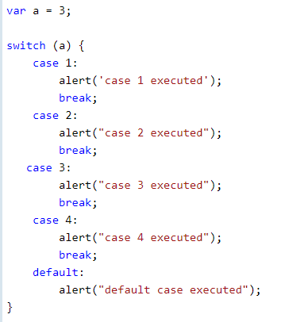
Switch
The switch is a conditional statement like if statement. Switch is useful when you want to execute one of the multiple code blocks based on the return value of a specified expression.
The switch can includes multiple cases where each case represents a particular value. Code under particular case will be executed when case value is equal to the return value of switch expression. If none of the cases match with switch expression value then the default case will be executed.

Slide 96

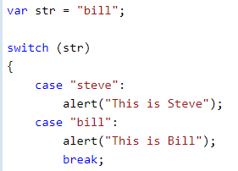
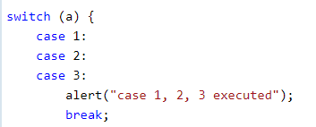
The switch statement can also include an expression.
The switch can also contain string type expression.
Multiple cases can be combined in a switch statement.

Slide 97
Exercise 3
Question 3.1: What is the value of the variable number after running the following code?
number = 15;
number += 10;
number /= number; // number = number / number
Question 3.2: How many times would the message “Hello!” be displayed to the user in the following for loop?
for (i = 1; i <=10; i= i * 2) {
alert("Hello!");
}
Question 3.3: How many times would the message “Hello!” be displayed to the user in the following while loop?
while (true) {
alert("Hello!"); }

Slide 98
Activity
Using while loops create a Fibonacci series less than 40

Slide 99
To view page source
https://www.webnots.com/view-webpage-source-css-in-google-chrome/
https://opentechschool.github.io/js-beginners-1/page1.html
https://www.learn-js.org/en/Variables_and_Types

